Slide 1
Number Systems
Week 1
Sumaiyah Zahid

Slide 2
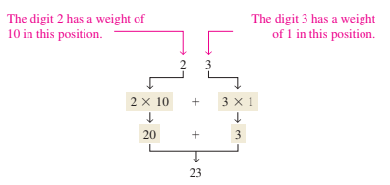
Decimal Number System

Slide 3
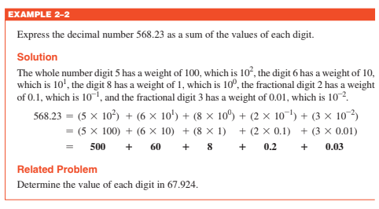
Decimal Number System

Slide 4
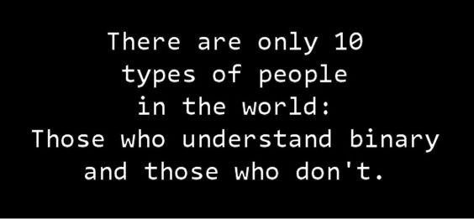
Binary Number System
There are two digits in the binary number system, 1 and 0.
Each digit is called a bit.
Binary + Digit = Bit

Slide 5
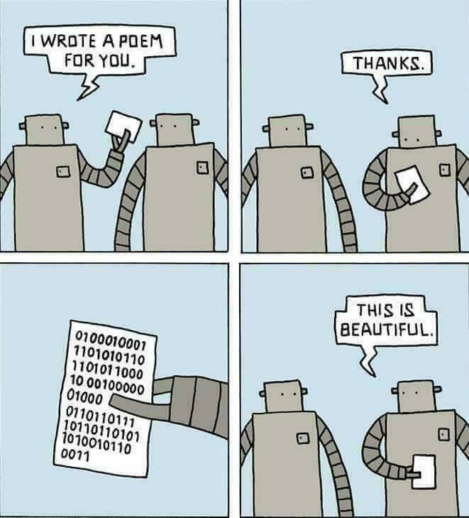
Binary Counting
With n bits you can count, 0 to 2n - 1.

Slide 6
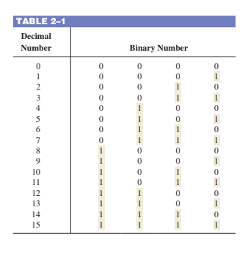
Binary Counting

Slide 7
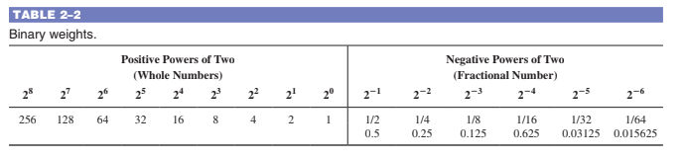
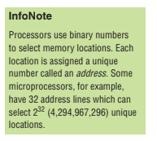

Slide 8
Binary To Decimal Conversion
Convert the binary whole number 1101101 to decimal.

Slide 9
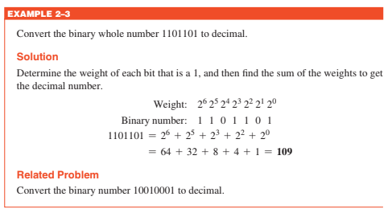
Binary To Decimal Conversion
Convert the binary whole number 1101101 to decimal.

Slide 10
Binary To Decimal Conversion
Convert the fractional binary number 0.1011 to decimal.

Slide 11
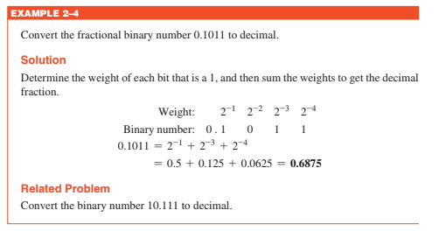
Binary To Decimal Conversion
Convert the fractional binary number 0.1011 to decimal.

Slide 12

Practice Questions
What is the largest decimal number that can be represented in binary with eight bits?
Determine the weight of the 1 in the binary number 10000.
Convert the binary number 10111101.011 to decimal.

Slide 13

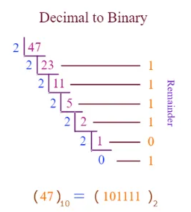
Decimal To Binary Conversion
Sum-of-Weights Method:
Repeated Division Method:

Slide 14

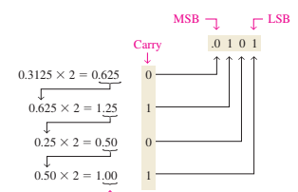
Decimal Fractions To Binary Conversion
Sum-of-Weights Method:
Repeated Multiplication Method:

Slide 15
Practice Questions
Convert each decimal number to binary by using the sum-of-weights method:
(a) 23 (b) 57 (c) 45.5
Convert each decimal number to binary by using the repeated division-by-2 method (repeated multiplication-by-2 for fractions):
(a) 14 (b) 21 (c) 0.375

Slide 16

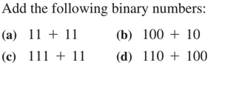
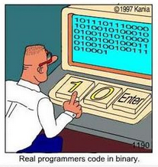
Binary Arithmetic
Binary Addition

Slide 17
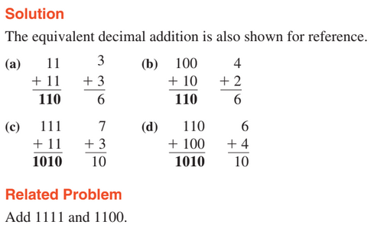
Binary Arithmetic

Slide 18
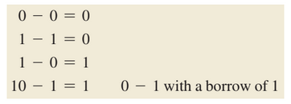
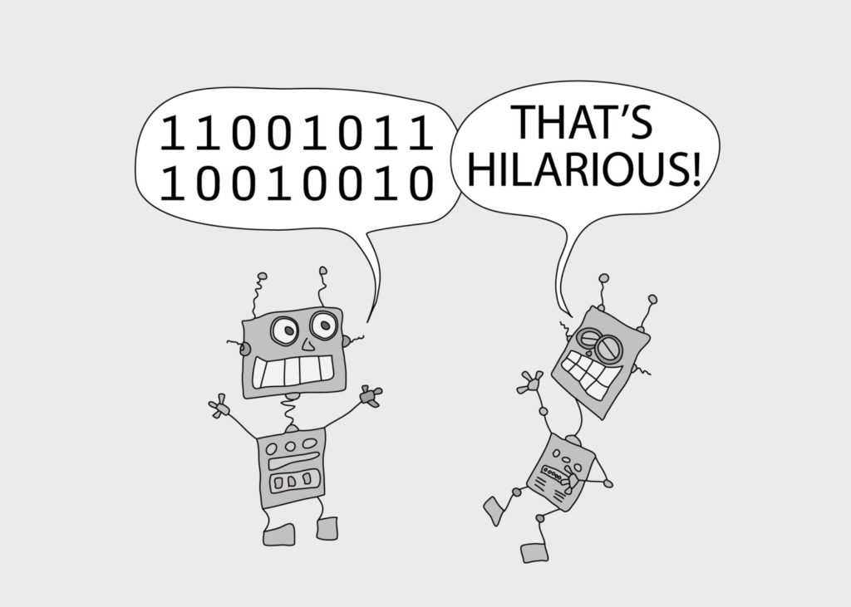
Binary Arithmetic
Binary Subtraction
Subtract 011 from 101

Slide 19
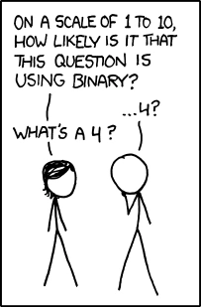
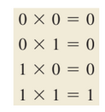
Binary Arithmetic
Binary Multiplication
Multiply 101 with 111

Slide 20
Binary Arithmetic
Binary Multiplication
Multiply 101 with 111

Slide 21
Binary Arithmetic
Binary Division
Divide 110 by 10

Slide 22
Practice Questions
1. Perform the following binary additions:
(a) 1101 + 1010 (b) 10111 + 01101
2. Perform the following binary subtractions:
(a) 1101 2 0100 (b) 1001 2 0111
3. Perform the indicated binary operations:
(a) 110 * 111 (b) 1100 , 011

Slide 23
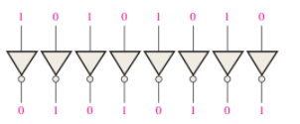
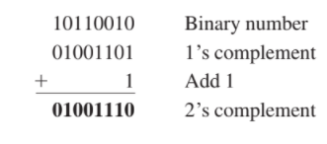
Complement Of Binary Number
1’s Complement
2’s complement = (1’s complement) + 1

Slide 24
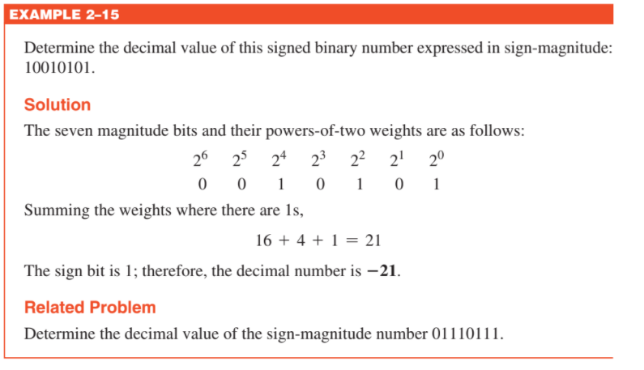
Signed Number
Sign Magnitude Form
The left-most bit in a signed binary number is the sign bit, which tells you whether the number is positive or negative.
0 -> positive number
1 -> negative number
e.g:
+25=00011001
-25=10011001

Slide 25
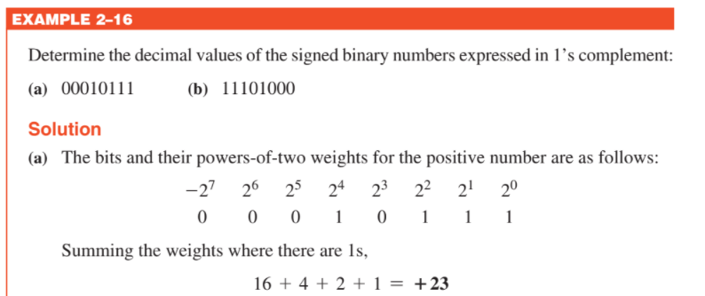
Signed Number
1’s Complement Form
+ve number is same as sign magnitude form
-ve number is the 1’s complement of the corresponding positive number
e.g:
+25=00011001
-25=11100110

Slide 26
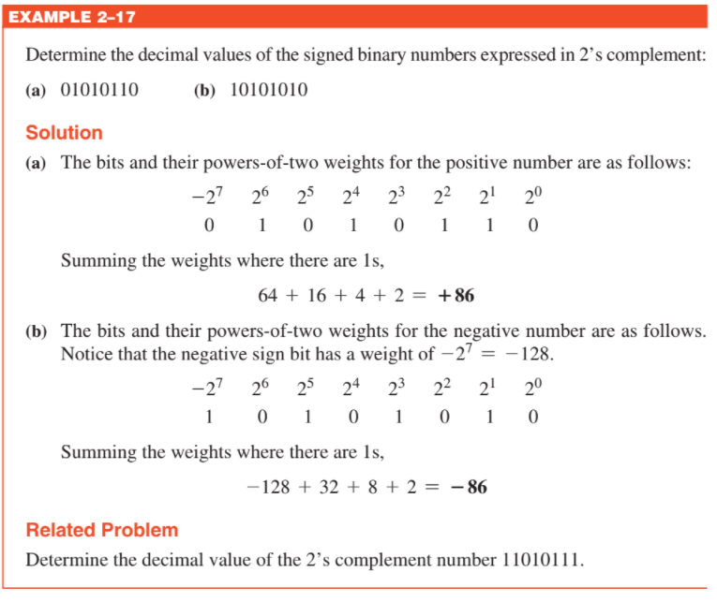
Signed Number
2’s Complement Form
+ve number is same as sign magnitude form
-ve number is the 2’s complement of the corresponding positive number
e.g:
+25=00011001
-25=11100111

Slide 27
Practice Questions
Express the decimal number +9 as an 8-bit binary number in the sign-magnitude system.
Express the decimal number 233 as an 8-bit binary number in the 1’s complement system.
Express the decimal number 246 as an 8-bit binary number in the 2’s complement system.

Slide 28
Binary Counting For Signed Numbers
With n bits you can count,
-2^(n-1) to 2^(n-1) - 1

Slide 29
Addition With Signed Numbers
Both numbers positive
Positive number with magnitude larger than negative number
Negative number with magnitude larger than positive number
Both numbers negative

Slide 30
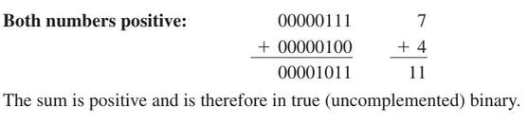
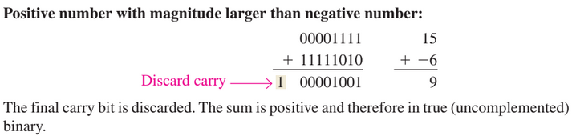
Addition With Signed Numbers

Slide 31
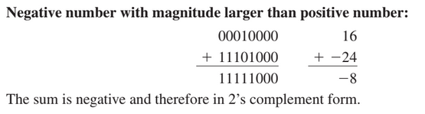
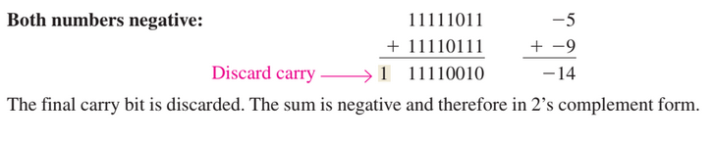
Addition With Signed Numbers
3.
4.

Slide 32
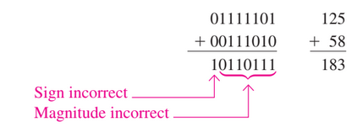
OverFlow Condition

Slide 33
SUbtraction With Signed Numbers
To subtract two signed numbers, take the 2’s complement of the subtrahend and add. Discard any final carry bit.
(a) 00001000 - 00000011 (b) 00001100 - 11110111

Slide 34
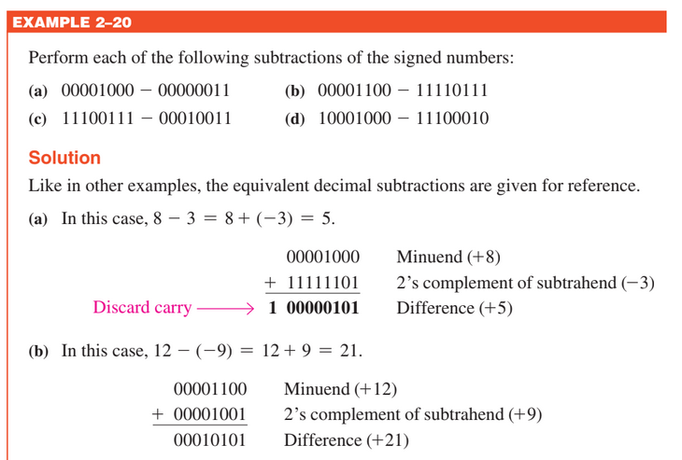
SUbtraction With Signed Numbers

Slide 35
Multiplication With Signed Numbers
• If the signs are the same, the product is positive.
• If the signs are different, the product is negative.
Determine if the signs of the multiplicand and multiplier are the same or different. This determines what the sign of the product will be.
Change any negative number to true (uncomplemented) form.
Multiply both numbers.
If the sign bit that was determined in step 1 is negative, take the 2’s complement of the product. If positive, leave the product in true form. Attach the sign bit to the product.

Slide 36
Multiplication With Signed Numbers
Multiply the signed binary numbers: 01010011 (multiplicand) and 11000101 (multiplier).

Slide 37

Multiplication With Signed Numbers
Multiply the signed binary numbers: 01010011 (multiplicand) and 11000101 (multiplier).

Slide 38
Division With Signed Numbers
• If the signs are the same, the result is positive.
• If the signs are different, the result is negative.
Determine if the signs of the divisor and dividend are the same or different. This determines what the sign of the result will be.
Change any negative number to true (uncomplemented) form.
Divide both numbers.
If the sign bit that was determined in step 1 is negative, take the 2’s complement of the product. If positive, leave the product in true form. Attach the sign bit to the product.

Slide 39
Division With Signed Numbers
Divide the signed binary numbers:
00001001 / 11111101

Slide 40
Practice Questions
Add the signed numbers 00100001 and 10111100.
Subtract the signed numbers 00110010 from 01110111.
Multiply 01111111 by 00000101.
Divide 00110000 by 00001100.

Slide 41
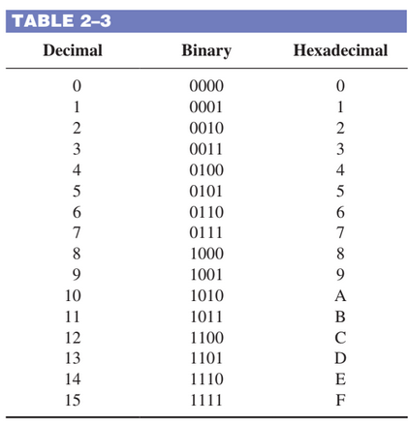
Hexadecimal Number System
Counting in Hexadecimal

Slide 42
Binary to HexaDecimal
Convert the following binary numbers to hexadecimal:
(a) 1100101001010111 (b) 111111000101101001

Slide 43
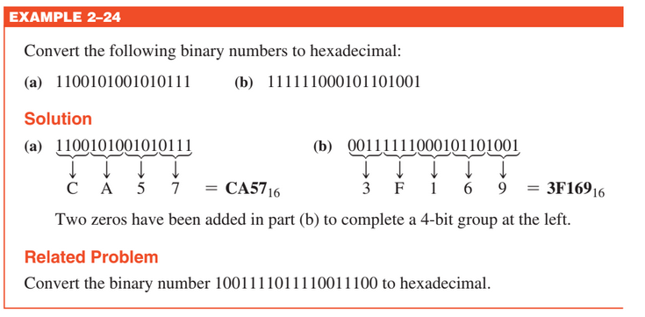
Binary to HexaDecimal

Slide 44
HexaDecimal To Binary
Determine the binary numbers for the following hexadecimal numbers:
(a) 10A416 (b) CF8E16 (c) 974216

Slide 45
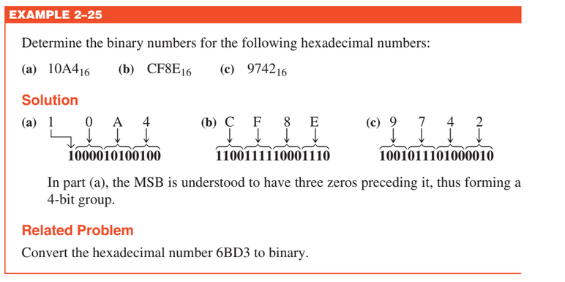
HexaDecimal To Binary

Slide 46
HexaDecimal To Decimal
Convert the following hexadecimal numbers to decimal:
(a) 1C16 (b) A8516

Slide 47
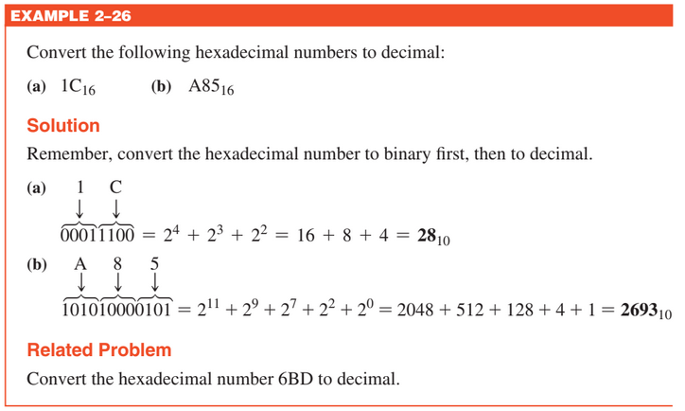
HexaDecimal To Decimal

Slide 48
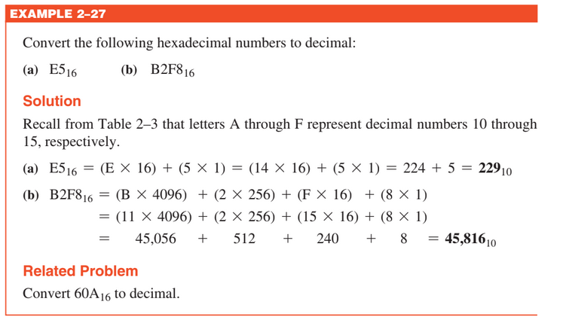
HexaDecimal To Decimal

Slide 49
Decimal To HexaDecimal
Convert the decimal number 650 to hexadecimal by repeated division by 16.

Slide 50

HexaDecimal Addition
Add the following hexadecimal numbers:

Slide 51

HexaDecimal Subtraction
Subtract the following hexadecimal numbers:

Slide 52
Practice Questions
Convert the following binary numbers to hexadecimal:(a) 10110011 (b) 11001110100
Convert the following hexadecimal numbers to binary:(a) 57 (b) 3A5 (c) F80B
Convert 9B3016 to decimal.
Convert the decimal number 573 to hexadecimal.
Add the following hexadecimal numbers directly: (a) 18 + 34 (b) 3F + 2A
Subtract the following hexadecimal numbers: (a) 75 - 21 (b) 94 - 5C

Slide 53
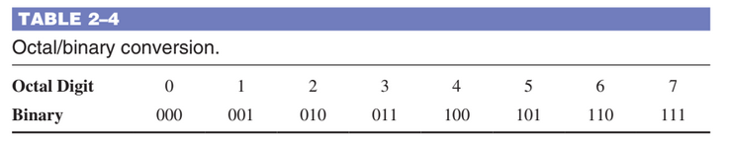
Octal Number System
Counting in Octal

Slide 54
Decimal to Octal and Octal To Decimal
Convert the following decimal numbers to octal:
(a) 359
Convert the following octal numbers to decimal:
(a) 2374

Slide 55
Decimal to Octal and Octal To Decimal
Convert the following decimal numbers to octal:
(a) 359 ------> 547 in octal
Convert the following octal numbers to decimal:
(a) 2374 -----> 1276 in decimal

Slide 56
Binary to Octal and Octal To Binary
Convert the following binary numbers to octal:
(a) 110101 (b) 101111001
Convert the following octal numbers to binary:
(a) 140 (b) 7526

Slide 57

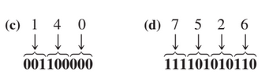
Binary to Octal and Octal To Binary
Convert the following binary numbers to octal:
(a) 110101 (b) 101111001
Convert the following octal numbers to binary:
(c) 140 (d) 7526

Slide 58
Practice Questions
1. Convert the following octal numbers to decimal:
(a) 73 (b) 125
2. Convert the following decimal numbers to octal:
(a) 9810 (b) 16310
3. Convert the following octal numbers to binary:
(a) 468 (b) 7238 (c) 56248
4. Convert the following binary numbers to octal:
(a) 110101111 (b) 1001100010 (c) 10111111001

Slide 59
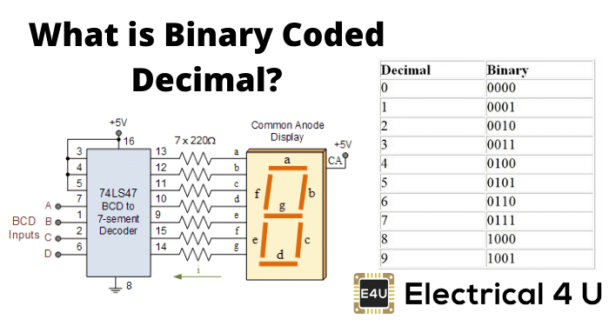
Binary Coded Decimal
8421 BCD Code
Invalid Codes
Digital clocks
Digital thermometers
Digital meters

Slide 60
Decimal to BCD and BCD to Decimal
Convert each of the following decimal numbers to BCD:
(a) 35 (b) 98 (c) 170 (d) 2469
Convert each of the following BCD codes to decimal:
(a) 10000110 (b) 001101010001 (c) 1001010001110000

Slide 61
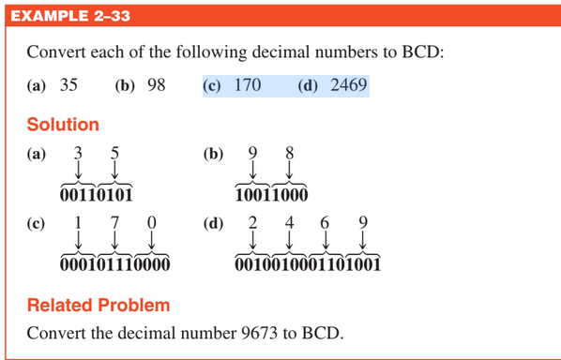
Decimal to BCD and BCD to Decimal

Slide 62
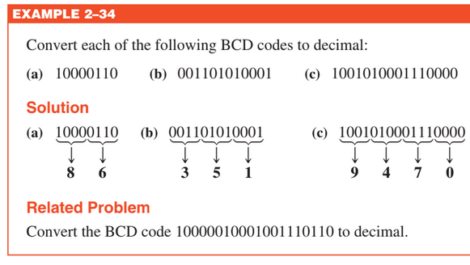
Decimal to BCD and BCD to Decimal

Slide 63
BCD Addition
Add the following BCD numbers:
(a) 0011 + 0100 (b) 00100011 + 00010101
(c) 10000110 + 00010011 (d) 010001010000 + 010000010111

Slide 64
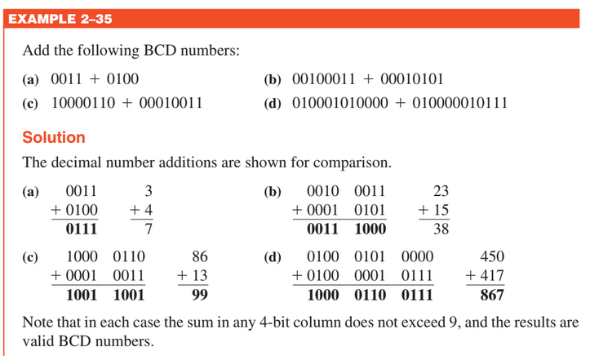
BCD Addition

Slide 65
BCD Addition
Add the following BCD numbers:
(a) 1001 + 0100 (b) 1001 + 1001
(c) 00010110 + 00010101 (d) 01100111 + 01010011

Slide 66
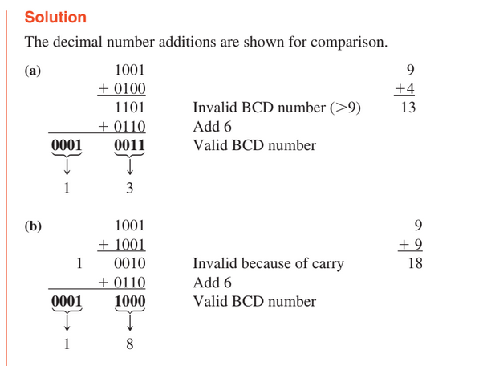
BCD Addition

Slide 67
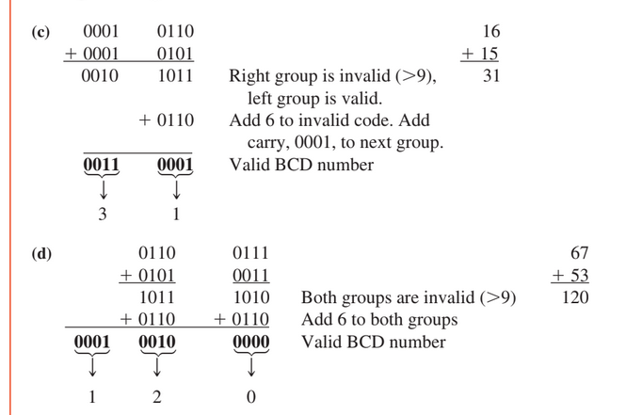
BCD Addition

Slide 68
Practice Questions
Convert the following decimal numbers to BCD:
(a) 6 (b) 15 (c) 273 (d) 849
What decimal numbers are represented by each BCD code?
(a) 10001001 (b) 001001111000
(c) 000101010111

Slide 69
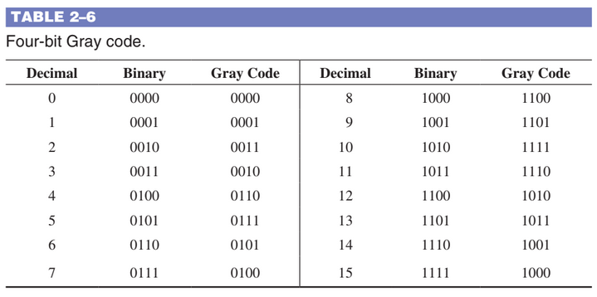
GRAY Code

Slide 70

Binary To Gray Code
(a) Convert the binary number 11000110 to Gray code.

Slide 71

Gray To Binary Code
(b) Convert the Gray code 10101111 to binary.

